Slide 1
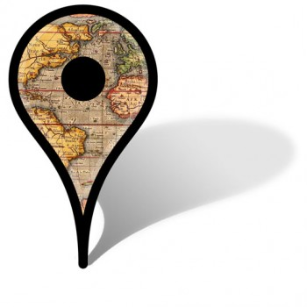
All Maps Lie
Critical cartography and decolonising GIS
Dr Sydney J Shep, Rhys Owen, Rere-No-A-Rangi Pope
Te Whare Tā o Waiteata : : Wai-te-ata Press
wtapress@vuw.ac.nz

Slide 2
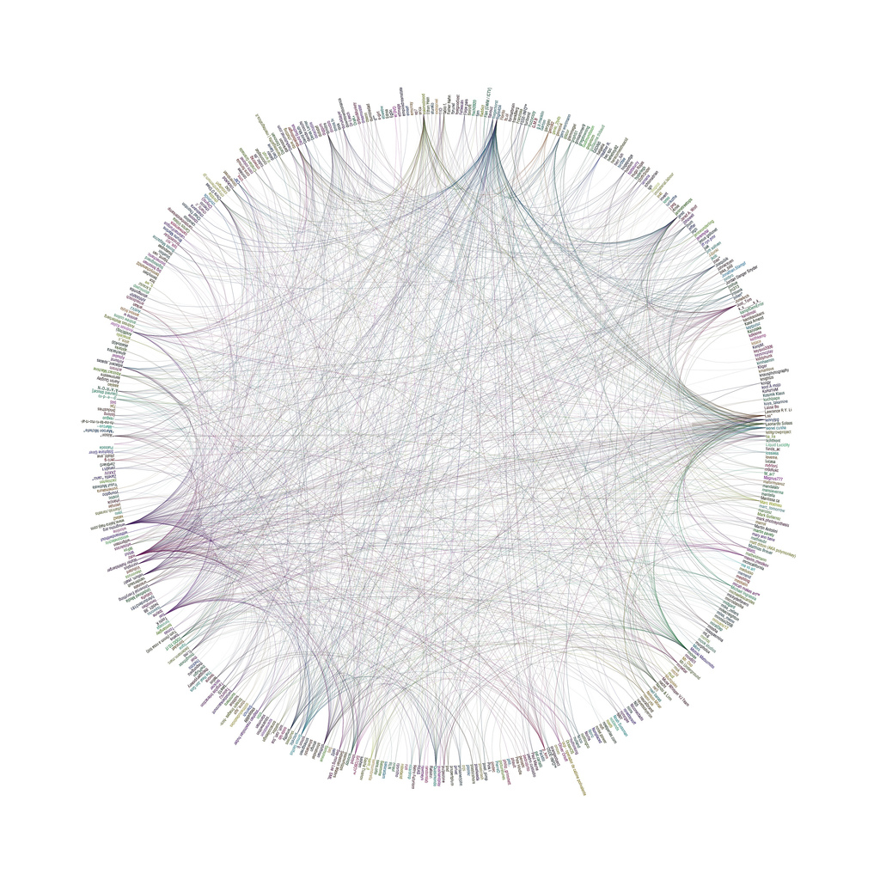
map for today
What kind(s) of stories do maps tell? Or not tell?
Who is telling the story and what version of reality is represented?
What authority structures are promoted/reinforced?
What is at stake when you make a map?
Why are some maps more difficult to make than others?
What happens when you don’t have data?
What are mapmakers’ social responsibilities?
Andreas Koberle, http://www.flickr.com/photos/eskimoblood/2111672366/

Slide 3
The Spatial Turn in History
History is just not about time but space as well = “spacetime continuum” = time is a human construct for representing movement through space [Alfred Einstein]
Historical GIS [HGIS], spatial history, spatially-enabled history, deep mapping
Definitions:
Space: measurable, physical form
Place: socially constructed and local, infused with human meaning
Location: specific area defined by geo-coordinates
Site: specific location
Notes:
Charles Withers, https://www.jstor.org/stable/20621915?seq=1#metadata_info_tab_contents

Slide 4
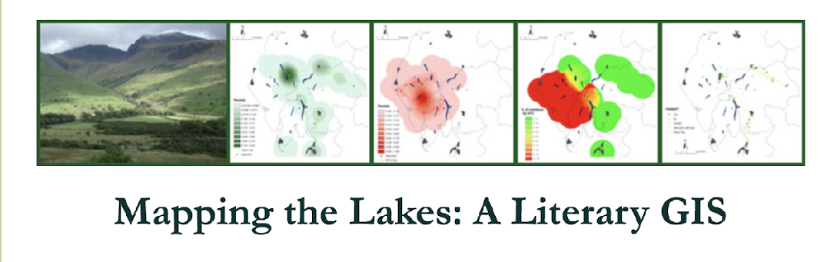
< place-making >
“The past cannot exist in time; only in space. All human action takes and makes place. The past is a set of places made by human action. History is a map of those places.”
Philip J. Ethington, “Placing the Past: ‘Groundwork’ for a Spatial Theory of History,” Rethinking History 11:4 (December 2007): 465-93; 465.
“'Mapping the Lakes' maps out two textual accounts of journeys through the landscape of the Lake District: Thomas Gray's tour of the region in the autumn of 1769; and Samuel Taylor Coleridge's 'circumcursion' of the area in August 1802. This website offers GIS representations of these two accounts of place and suggests ways in which the mapping process opens up spatial thinking about these geo-specific texts. The project also offers general reflections on the intersections of digital cartography and electronic textuality, paving the way for future research on the literature of landscape and environment.” https://www.lancaster.ac.uk/mappingthelakes/

Slide 5
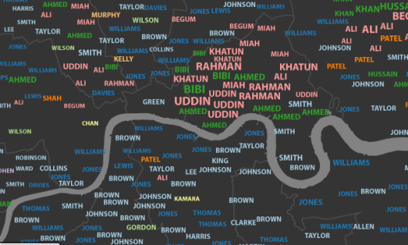
The problem
How can geospatial technology capture a sense of ‘place’ when it is generated through “activities, emotional linkages, social bonds, and other… behaviours that are harder to represent in stasis or concretely” (Rumsey, 2009, p. 6)?
http://makingamovablefeast.wordpress.com/2012/08/20/london-cultural-geography/

Slide 6
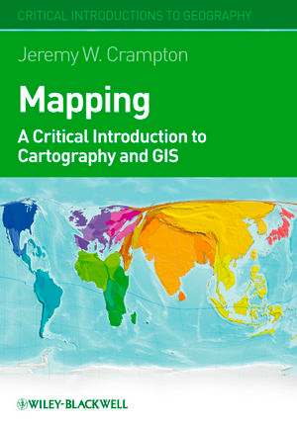
“Critical cartography and GIS however conceives of mapping as embedded in specific relations of power. That is, mapping is involved in what we choose to represent, how we choose to represent objects such as people and things, and what decisions are made with those representations. In other words, mapping is in and of itself a political process.”
(Crampton, 2010, 41).
Notes:
Compare to Benedict Anderson talking about the 3 most potent instrument of power and nation-making: census, map and museum: census counts and categorises people, you’re in or you’re out; maps draw boundaries and define the spaces of nations; museums archive the records of power. History is told by the winners.
Jeremy Crampton (2010); See also chapter 8: GIS After Critique: What Next?

Slide 7
“Stay with the trouble” Donna Haraway
S uspicion of master narratives of knowledge
T ools of knowledge gathering and dissemination
O bjection to objectivity
R eflexivity of the positioning of researchers
Y earning for and working for transformation and change
Sarojini Nadar, “’Stories are data with Soul’ –
lessons from black feminist epistemology,” Agenda 28:1 (2014). https://doi.org/10.1080/10130950.2014.871838
Notes:
Sarojini Nadar, “’Stories are data with Soul’ – lessons from black feminist epistemology,” Agenda 28:1 (2014). https://doi.org/10.1080/10130950.2014.871838

Slide 8
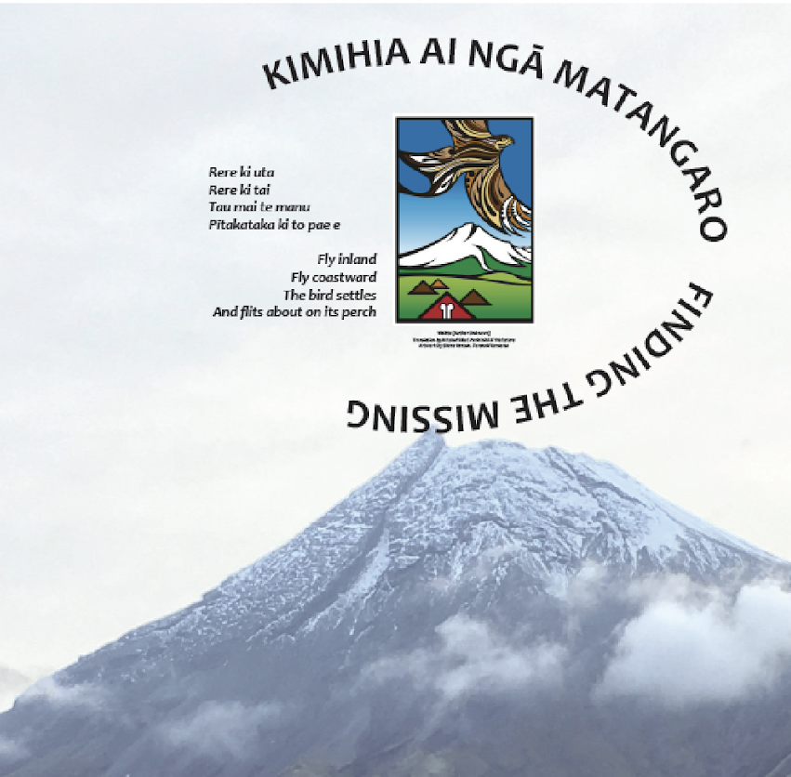

Slide 9
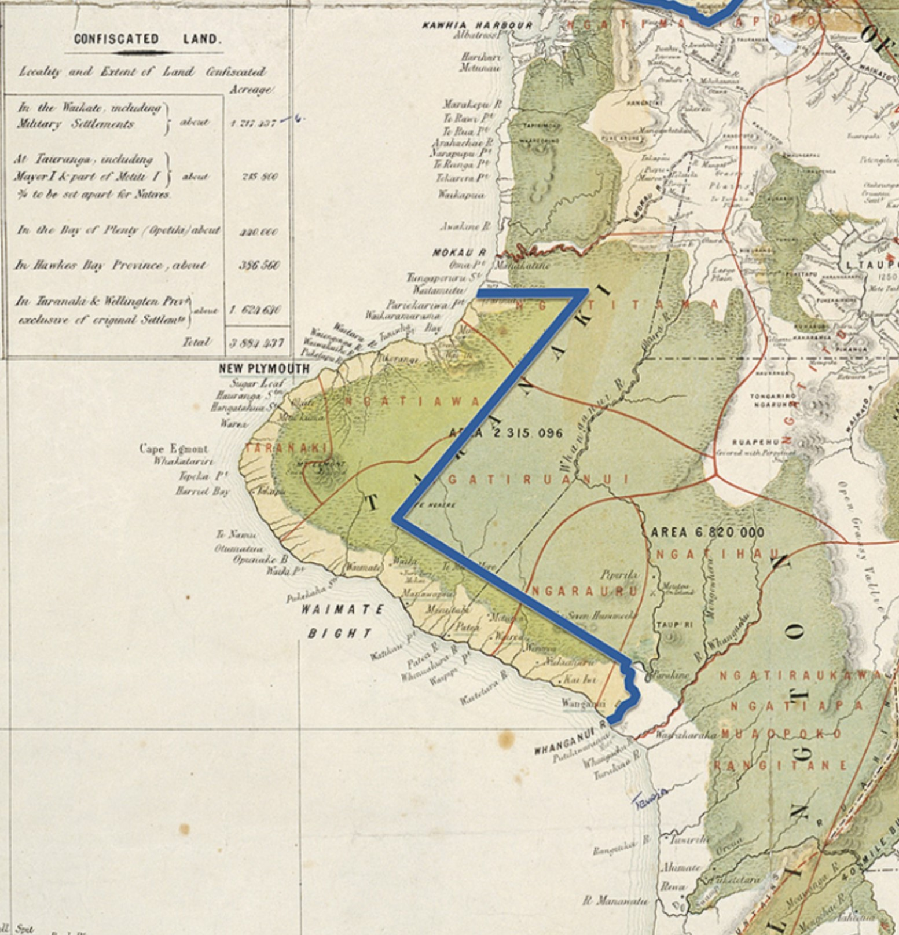
Kimihia te matangaro kia whakapakari te hononga
“finding the missing in order to strengthen their connection”
A project funded by the SfTI National Science Challenge, with Victoria and Auckland Universities, and Parininihi ki Waitotara
Retrieved from: https://teara.govt.nz/en/zoomify/33583/confiscation-map-1869 19/11/2019

Slide 10
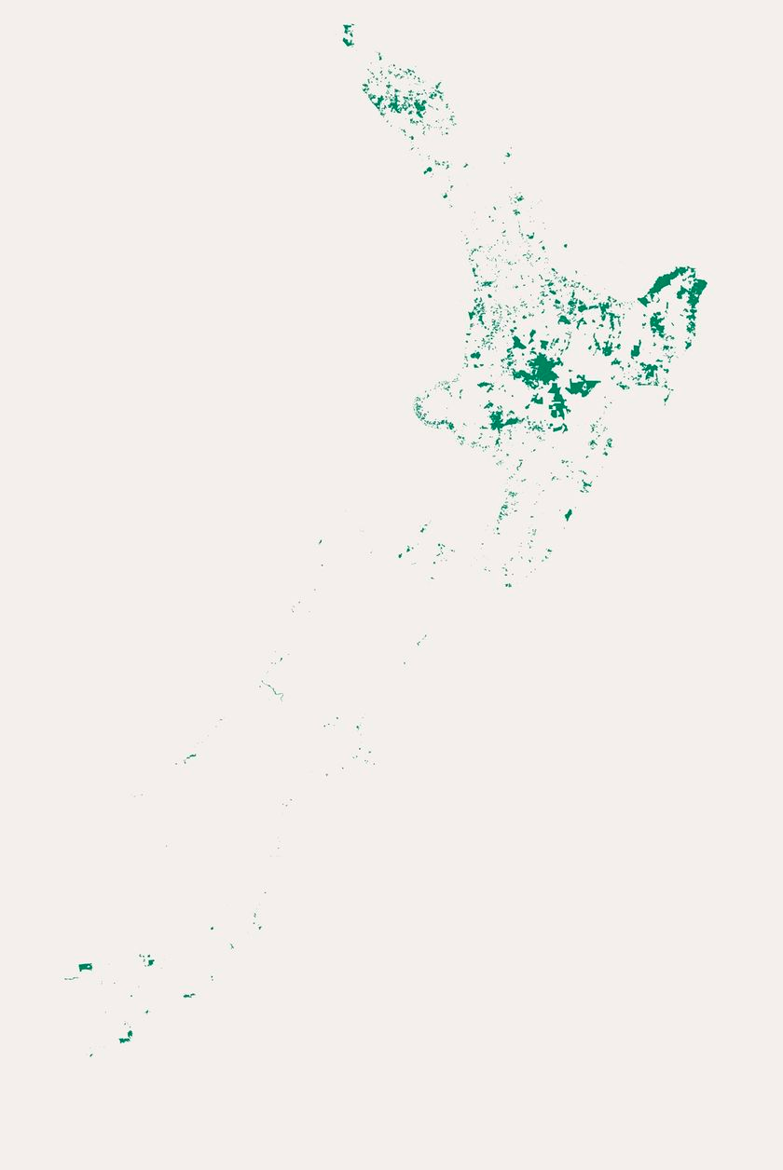
Notes:
Different versions of reality what you see, what I see
“0-Landloss-All-4d0af4f9.Gif (750×1107).” Accessed February 9, 2020. https://static3.stuff.co.nz/0-landloss-all-4d0af4f9.gif.
“New Zealand Made / Nā Niu Tīreni.” Stuff, July 2018. https://interactives.stuff.co.nz/2018/07/na-niu-tireni-new-zealand-made/.

Slide 11
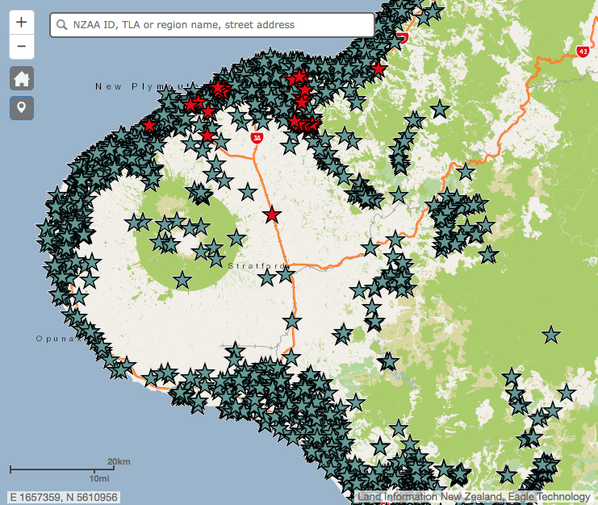
Notes:
PKW Wahi tapū project
Whose story? Whose data? Whose map?
How do you / can you / should you map oral narratives?
Social, cultural, ethical responsibilities of mapmakers

Slide 12
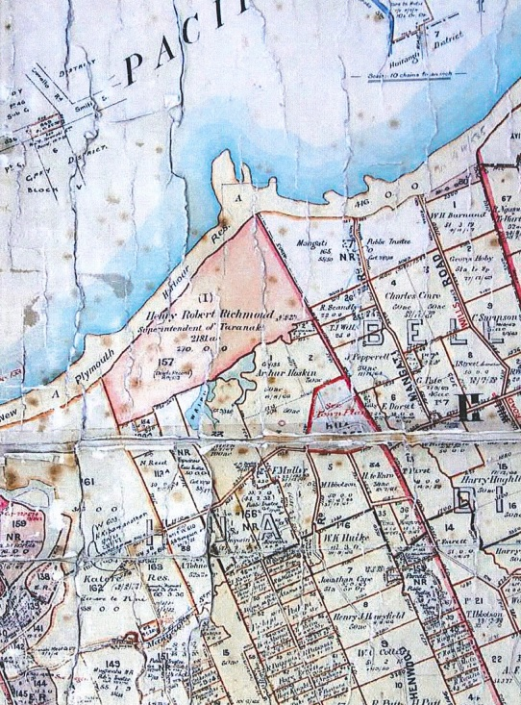
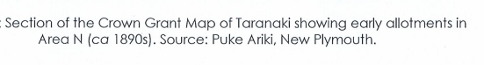

Slide 13
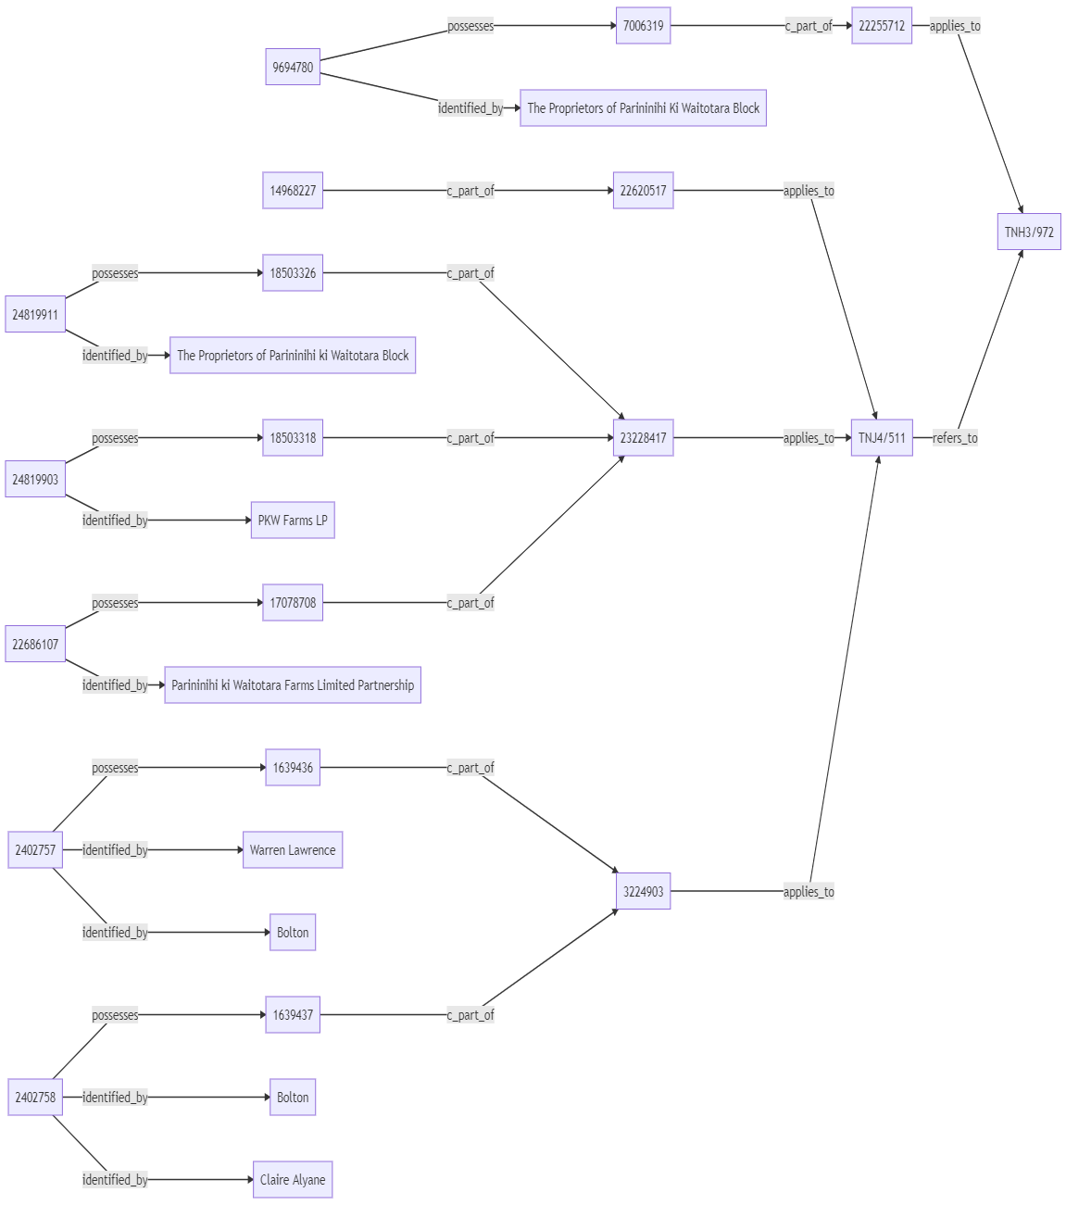
Exploring and expressing the whakapapa of whenua
linked.art

Slide 14
Key Challenges
GIS is as much a visual language as a scientific / technical one
Technology drives representations: normalisation
How do you represent ambiguity / imprecision / gaps in archival data? not everything can be fixed as a point, line, or polygon
(Im)-possibility of cross-cultural narratives: geonarratives
Mapping personal spatial relationships: positionality
Plotting identity / belonging / emotion: reflexivity
What is gained / lost in process of creating ‘maps’ as an aid to understanding?
Notes:
“Historian David Bodenhamer eloquently argues that GIS is fundamentally ill-suited to humanistic research. Because GIS ‘privileges disambiguation in its organization of knowledge, whereas the humanities treat knowledge as multivalent, equivocal, and protean’, scholars should look to other digital and spatial technologies to construct spatial narratives, using a process he calls deep mapping, roughly the spatial equivalent of anthropologists’ thick description (pp. 6, 10–12). ‘Ultimately’, Bodenhamer predicts, ‘what will compel attention from historians and other humanities scholars are the broader ontological and epistemological issues of geographic information science (GISci) and not GIS as a method and technique’ (p. 7).” Anne Knowles (2014) The contested nature of historical GIS, International Journal of Geographical Information Science, 28:1, 206-211,DOI: 10.1080/13658816.2013.850696
Mark Palmer. Theorizing indigital geographic information networks. Cartographica: The International Journal
for Geographic Information and Geovisualization, 47(2):80–91, 2012. doi: 10.3138/carto.47.2.80.
HGIS has been ’indigitalization’ described by Palmer [2012] as “the amalgamation of indigenous, scientific and digital technological knowledge systems; characterised as fragmentary, contradictory, and full of uncertainties.”

Slide 15
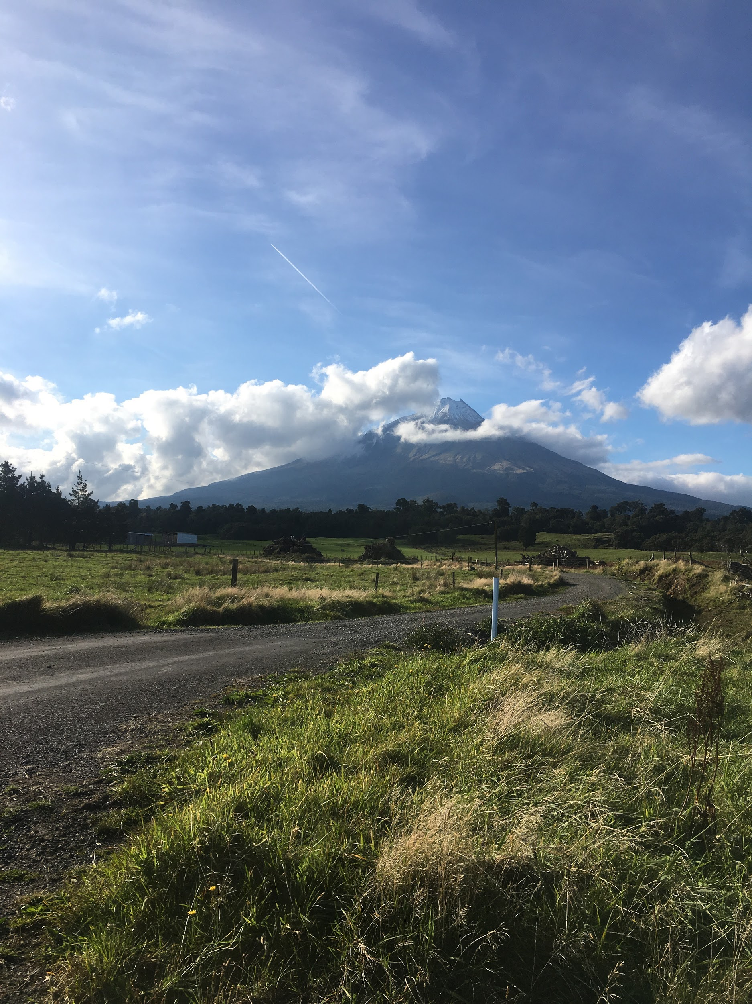
Otakeho, Taranaki 2019

